Slide 1
Feature Scaling

Slide 2
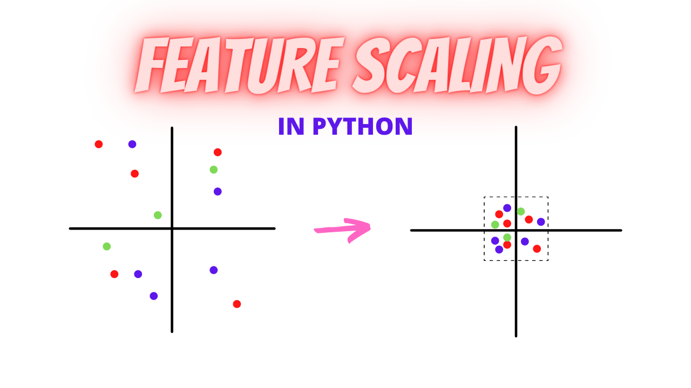
What is Feature Scaling?
In data pre-processing, we try to change the data in such a way that the model can process it without any problems.

Slide 3
What is Feature Scaling?
Feature Scaling is one such process in which we transform the data into a better version.
Feature Scaling is done to normalize the features in the dataset into a finite range.

Slide 4
What is Feature Scaling?
Feature Scaling is one such process in which we transform the data into a better version.
Feature Scaling is done to normalize the features in the dataset into a finite range.

Slide 5
House ID | Price (USD) | Lot Size (sq ft) | Distance to City Center (km) | Number of Rooms | Age of House (years)
H001 | 850,000 | 6,500 | 12.4 | 3 | 28
H002 | 1,250,000 | 12,300 | 5.6 | 5 | 12
H003 | 420,000 | 3,200 | 18.9 | 2 | 42
H004 | 2,300,000 | 20,500 | 3.1 | 7 | 5
H005 | 690,000 | 8,700 | 15.2 | 4 | 31
For example, in a house price dataset. It will have many features such as number of bedrooms, lot size, distance to the city center, number of rooms and house age.

Slide 6
House ID | Price (USD) | Lot Size (sq ft) | Distance to City Center (km) | Number of Rooms | Age of House (years)
H001 | 850,000 | 6,500 | 12.4 | 3 | 28
H002 | 1,250,000 | 12,300 | 5.6 | 5 | 12
H003 | 420,000 | 3,200 | 18.9 | 2 | 42
H004 | 2,300,000 | 20,500 | 3.1 | 7 | 5
H005 | 690,000 | 8,700 | 15.2 | 4 | 31
For the price column, we can see that the price has a wide range which starts at 420 thousand and up to 2.3 million

Slide 7
House ID | Price (USD) | Lot Size (sq ft) | Distance to City Center (km) | Number of Rooms | Age of House (years)
H001 | 850,000 | 6,500 | 12.4 | 3 | 28
H002 | 1,250,000 | 12,300 | 5.6 | 5 | 12
H003 | 420,000 | 3,200 | 18.9 | 2 | 42
H004 | 2,300,000 | 20,500 | 3.1 | 7 | 5
H005 | 690,000 | 8,700 | 15.2 | 4 | 31
For the Lot Size column, its values also have a wide range starting from 3,200 up to 20,500

Slide 8
House ID | Price (USD) | Lot Size (sq ft) | Distance to City Center (km) | Number of Rooms | Age of House (years)
H001 | 850,000 | 6,500 | 12.4 | 3 | 28
H002 | 1,250,000 | 12,300 | 5.6 | 5 | 12
H003 | 420,000 | 3,200 | 18.9 | 2 | 42
H004 | 2,300,000 | 20,500 | 3.1 | 7 | 5
H005 | 690,000 | 8,700 | 15.2 | 4 | 31
While Distance, Rooms, and Age are in very small ranges

Slide 9
House ID | Price (USD) | Lot Size (sq ft) | Distance to City Center (km) | Number of Rooms | Age of House (years)
H001 | 850,000 | 6,500 | 12.4 | 3 | 28
H002 | 1,250,000 | 12,300 | 5.6 | 5 | 12
H003 | 420,000 | 3,200 | 18.9 | 2 | 42
H004 | 2,300,000 | 20,500 | 3.1 | 7 | 5
H005 | 690,000 | 8,700 | 15.2 | 4 | 31
This is a huge difference in the range of all features.

Slide 10
House ID | Price (USD) | Lot Size (sq ft) | Distance to City Center (km) | Number of Rooms | Age of House (years)
H001 | 850,000 | 6,500 | 12.4 | 3 | 28
H002 | 1,250,000 | 12,300 | 5.6 | 5 | 12
H003 | 420,000 | 3,200 | 18.9 | 2 | 42
H004 | 2,300,000 | 20,500 | 3.1 | 7 | 5
H005 | 690,000 | 8,700 | 15.2 | 4 | 31
Algorithms that use distances (kNN, K-Means), gradient-based optimization (linear/logistic regression), or regularization will treat Price and Lot Size as more “important”…

Slide 11
House ID | Price (USD) | Lot Size (sq ft) | Distance to City Center (km) | Number of Rooms | Age of House (years)
H001 | 850,000 | 6,500 | 12.4 | 3 | 28
H002 | 1,250,000 | 12,300 | 5.6 | 5 | 12
H003 | 420,000 | 3,200 | 18.9 | 2 | 42
H004 | 2,300,000 | 20,500 | 3.1 | 7 | 5
H005 | 690,000 | 8,700 | 15.2 | 4 | 31
Simply because their numeric scales dominate the others. That is unless we scale the features.

Slide 12
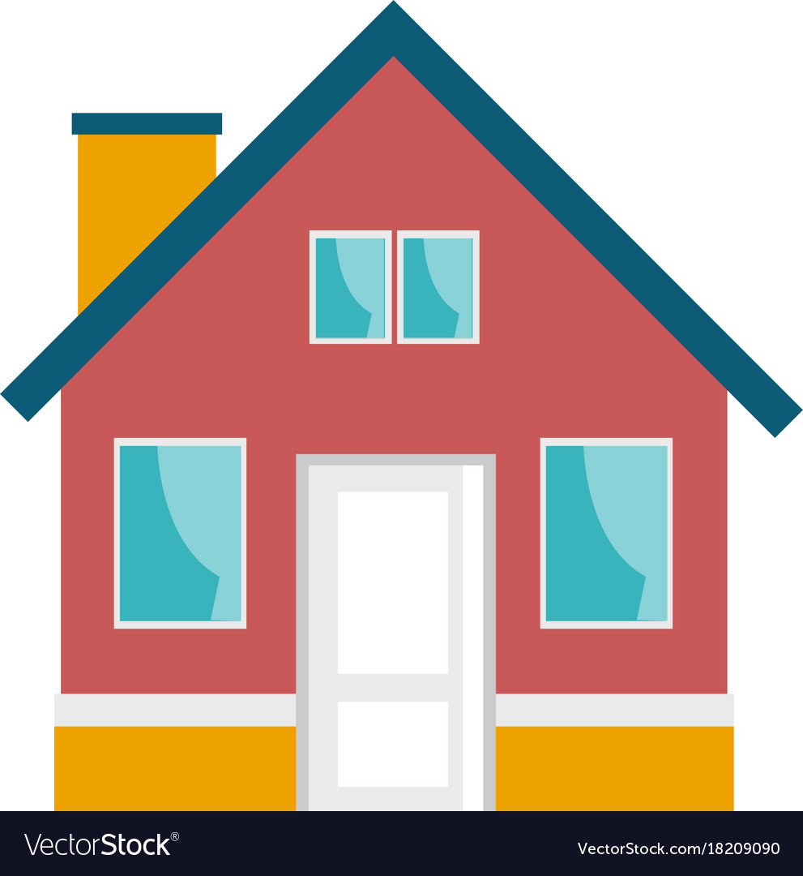
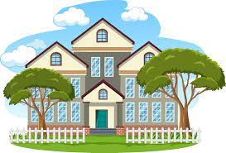
Why Feature Scaling?
Real Life Datasets have many features with a wide range of values

Slide 13
Why Feature Scaling?
Many machine learning algorithms attempt to find trends in the data by comparing features of data points. However, there is an issue when the features are on drastically different scales.

Slide 14
House ID | Number of Rooms | Age of House (years)
H001 | 2 | 1
H002 | 5 | 12
H002 | 2 | 42
… | … | …
H990 | 20 | 100
For example, consider a dataset of houses. Two potential features might be the number of rooms in the house, and the total age of the house in years.

Slide 15
House ID | Number of Rooms | Age of House (years)
H001 | 2 | 1
H002 | 5 | 12
H002 | 2 | 42
… | … | …
H990 | 20 | 100
A machine learning algorithm could try to predict which house would be best for you.

Slide 16
House ID | Number of Rooms | Age of House (years)
H001 | 2 | 1
H002 | 5 | 12
H002 | 2 | 42
… | … | …
H990 | 20 | 100
However, when the algorithm compares data points, the feature with the larger scale will completely dominate the other.

Slide 17
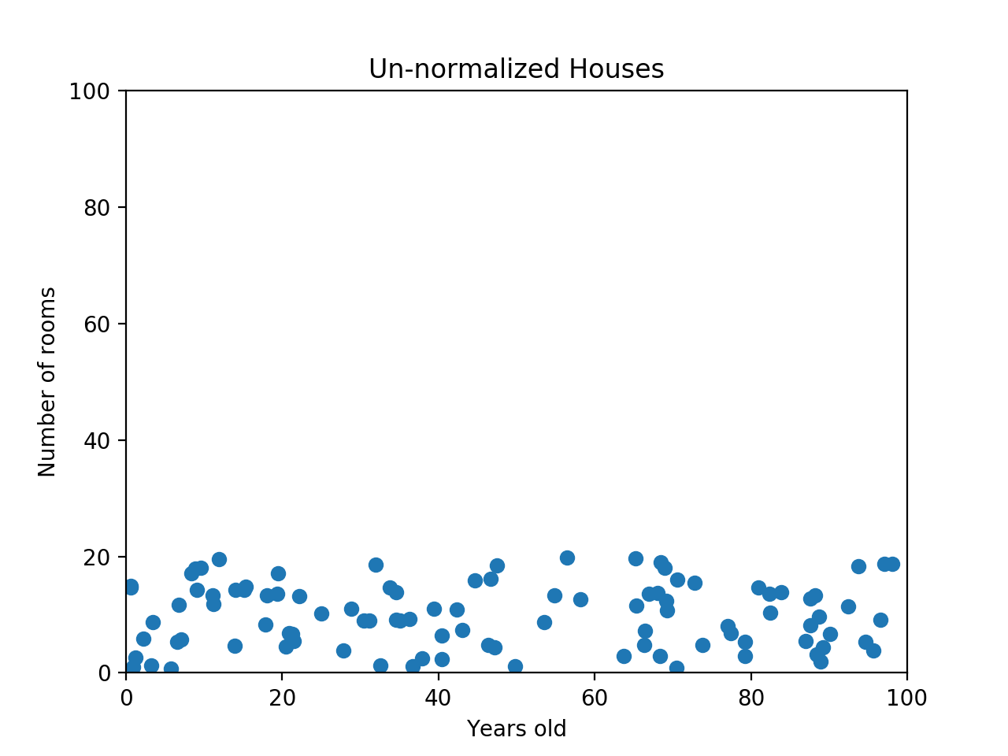
For example, if we use a scatter plot to visualize our data by the age of the house in years and number of rooms, notice that it has a certain pattern.

Slide 18
When the data looks squished like that, we know we have a problem

Slide 19
If we have a dataset like this, the machine learning algorithm should realize that there is a huge difference between a house with 2 rooms and a house with 20 rooms.

Slide 20
But right now, because two houses can be 100 years apart, the difference in the number of rooms contributes less to the overall difference.

Slide 21
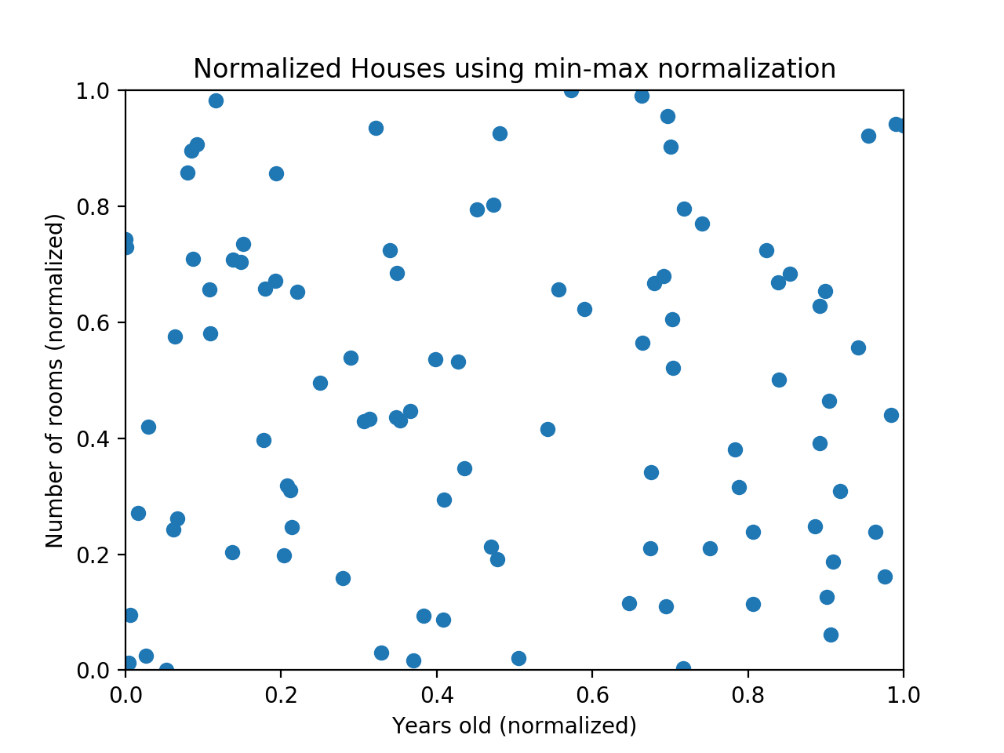
The goal of normalization is to make every datapoint have the same scale so each feature is equally important.

Slide 22
The image above shows the same house data normalized using min-max normalization.

Slide 23
Min-Max Normalization
Min-max normalization is one of the most common ways to normalize data.
For every feature, the minimum value of that feature gets transformed into a 0, the maximum value gets transformed into a 1, and every other value gets transformed into a decimal between 0 and 1.

Slide 24
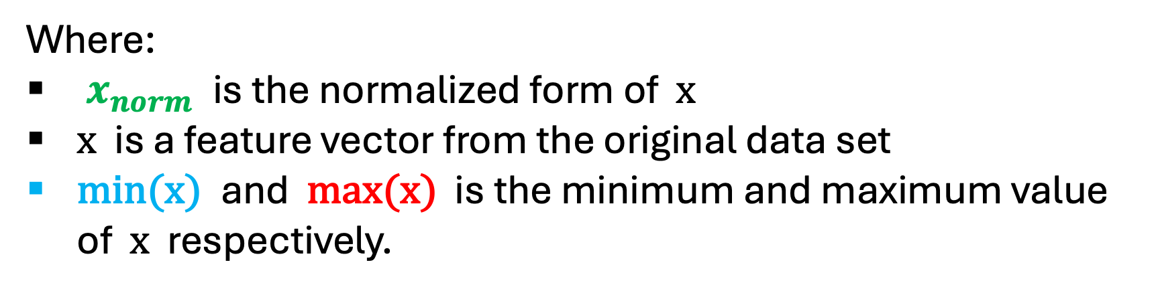
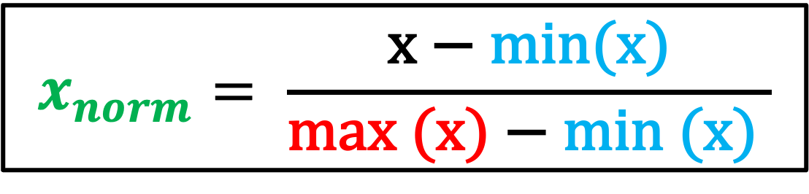
Min-Max Normalization
$$x_{norm}= \frac{\text{x} \text{− }\text{min}\text{(}\text{x}\text{)}}{\text{max} \text{(}\text{x}\text{) − }\text{min}\text{ (}\text{x}\text{)} }$$
Where:
$x_{norm}$ is the normalized form of x
x is a feature vector from the original data set
min(x) and max(x) is the minimum and maximum value of x respectively.

Slide 25
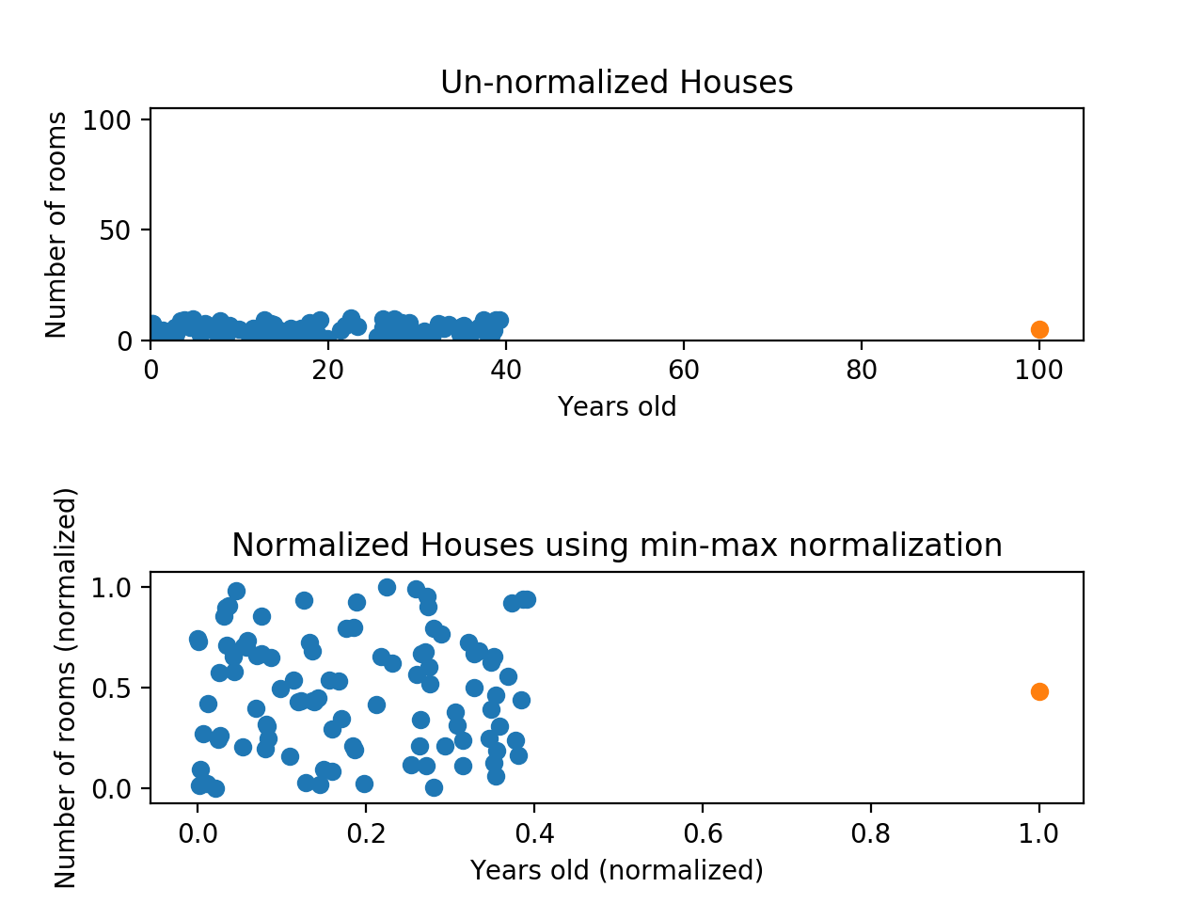
Min-max normalization has one fairly significant downside.
it does not handle outliers very well

Slide 26
For example, if you have 99 values between 0 and 40, and one value is 100…

Slide 27
Then the 99 values will all be transformed to a value between 0 and 0.4.

Slide 28
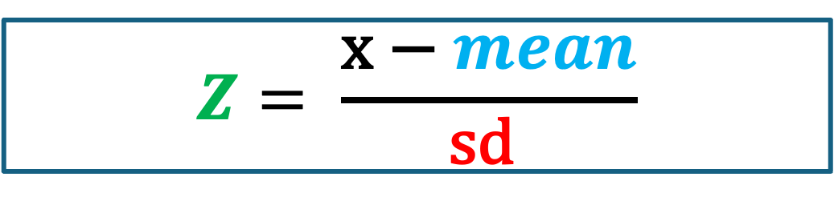
Z-Score Normalization
Z-score normalization is a strategy of normalizing data that avoids the outlier issue.
The formula for Z-score normalization is given by:
$$Z= \frac{\text{x} \text{− }mean}{\text{sd} }$$

Slide 29
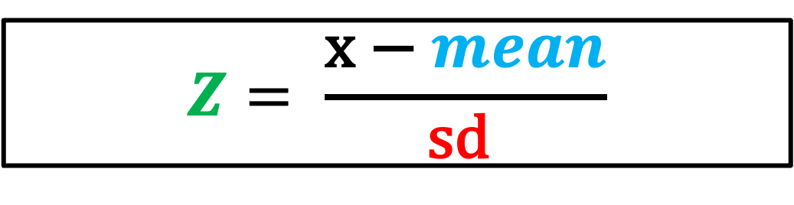
Z-Score Normalization
$$Z= \frac{\text{x} \text{− }mean}{\text{sd} }$$
Where:
Z is the normalized form of x
x is the feature vector from the original data set
mean is the mean of the feature vector x
sd is the standard deviation of x

Slide 30
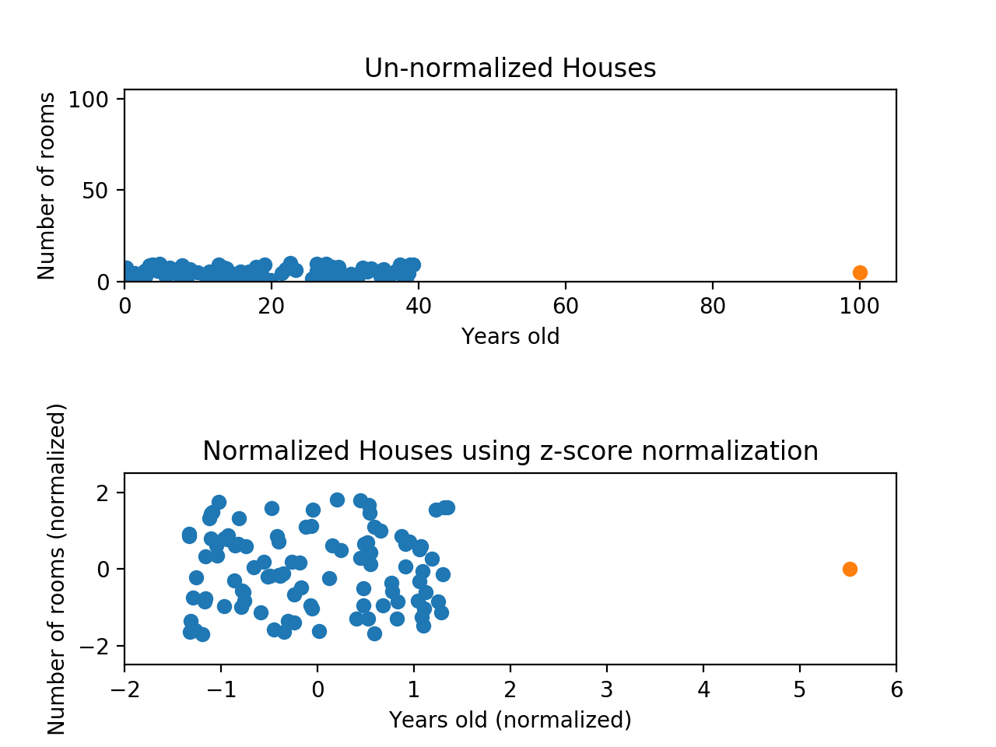
While the data still looks squished, notice that the points are now on roughly the same scale for both features

Slide 31
Almost all points are between -2 and 2 on both the x-axis and y-axis.

Slide 32
The only potential downside is that the features aren’t on the exact same scale.

Slide 33
With min-max normalization, we were guaranteed to reshape both of our features to be between 0 and 1.

Slide 34
Using z-score normalization, the x-axis now has a range from about -1.5 to 1.5 while the y-axis has a range from about -2 to 2.

Slide 35
This is certainly better than before. the x-axis, which previously had a range of 0 to 40, is no longer dominating the y-axis.

Slide 36
Machine Learning Models that require Scaling
Certain machine learning algorithms such as distance-based algorithms , curve-based algorithms or matrix factorization, decomposition or dimensionality reduction or gradient descent-based algorithms are sensitive towards feature scaling.

Slide 37
Machine Learning Models that require Scaling
And there are certain tree-based algorithms which are insensitive towards feature scaling as they are rule based algorithms such as Classification and Regression trees, Random Forests or Gradient Boosted decision Trees.

Slide 38
Algorithm | Feature Scaling
Linear Regression | YES
Logistic Regression | YES
KNN | YES
SVM | YES
Neural Networks | YES
Kmeans Clustering | YES
Random Forest | NO
Gradient Boosted Decision Trees | NO
Naïve Bayes | NO
PCA | YES
SVD | YES

Slide 39
Disadvantages of Feature Scaling
You will lose the original value will transforming to other values. So, there is loss of interpretation of the values.

Slide 40
Summary
Normalizing your data is an essential part of machine learning.
You might have an amazing dataset with many great features, but if you forget to normalize, one of those features might completely dominate the others. It’s like you’re throwing away almost all of your information! Normalizing solves this problem.

Slide 41
Summary
Having features on same scale that can contribute equally to the result. It can enhance the performance of machine learning algorithms.
If you don't scale features then large scale variables will dominate the small scale features.

Slide 42
Summary
Min-max normalization: Guarantees all features will have the exact same scale but does not handle outliers well.
Z-score normalization: Handles outliers, but does not produce normalized data with the exact same scale.

Slide 43
References
https://jisooleeworks.github.io/blog-site/2022/09/09/feature-scaling-min-max-z-score.html
https://vinaypaspula.substack.com/p/min-max-normalization-and-z-score-normalization-550988c2a990?utm_campaign=post&utm_medium=web

